Slide 1
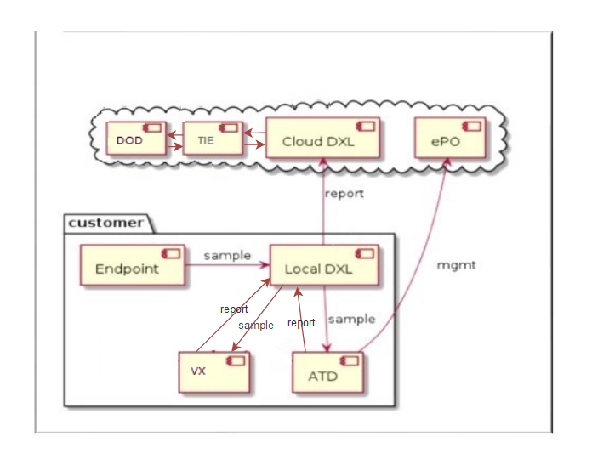

Slide 2

ePO
TIE
Cloud DXL
DOD
report
mgmt
Customer
Endpoint
sample
Local DXL
report
report
sample
report
sample
VX
ATD

Slide 3
